Slide 1
Topics to be covered
Pointers: Pointer Constants,Pointer Values, Pointer Variables, Accessing Variables Through Pointers, Pointer Declaration and Definition, Declaration versus Redirection, Initialization of Pointer Variables, Pointer for inter function communication, Pointer to pointers.
Arrays and Pointers: Pointer arithmetic and arrays, Memory allocation functions, static and dynamic memory allocation, array of pointers.
Strings: Input output functions, string handling functions.

Slide 2
Pointers
Objectives
❏ To understand the concept and use of pointers
❏ To be able to declare, define, and initialize pointers
❏ To write programs that access data through pointers
❏ To use pointers as parameters and return types
❏ To understand pointer compatibility, especially regarding pointers to pointers

Slide 3
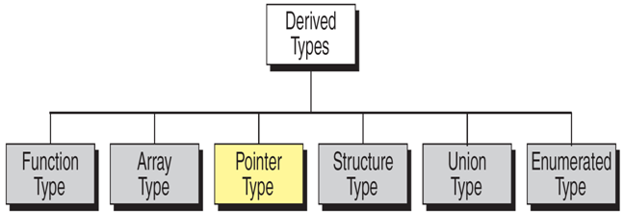
Derived Types

Slide 4
A pointer is a constant or variable that contains an address that can be used to access data. Pointers are built on the basic concept of pointer constants.

Slide 5
A Character Constant is a value and can be stored in a variable.
Character Constants and Variables

Slide 6
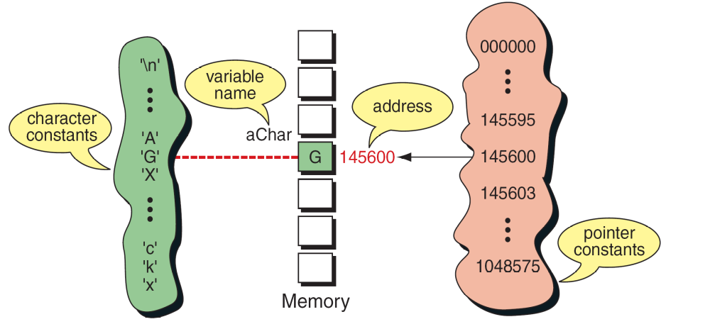
Pointer constants, drawn from the set of addresses for a computer, exist by themselves. We cannot change them;
we can only use them.
Pointer Constants

Slide 7
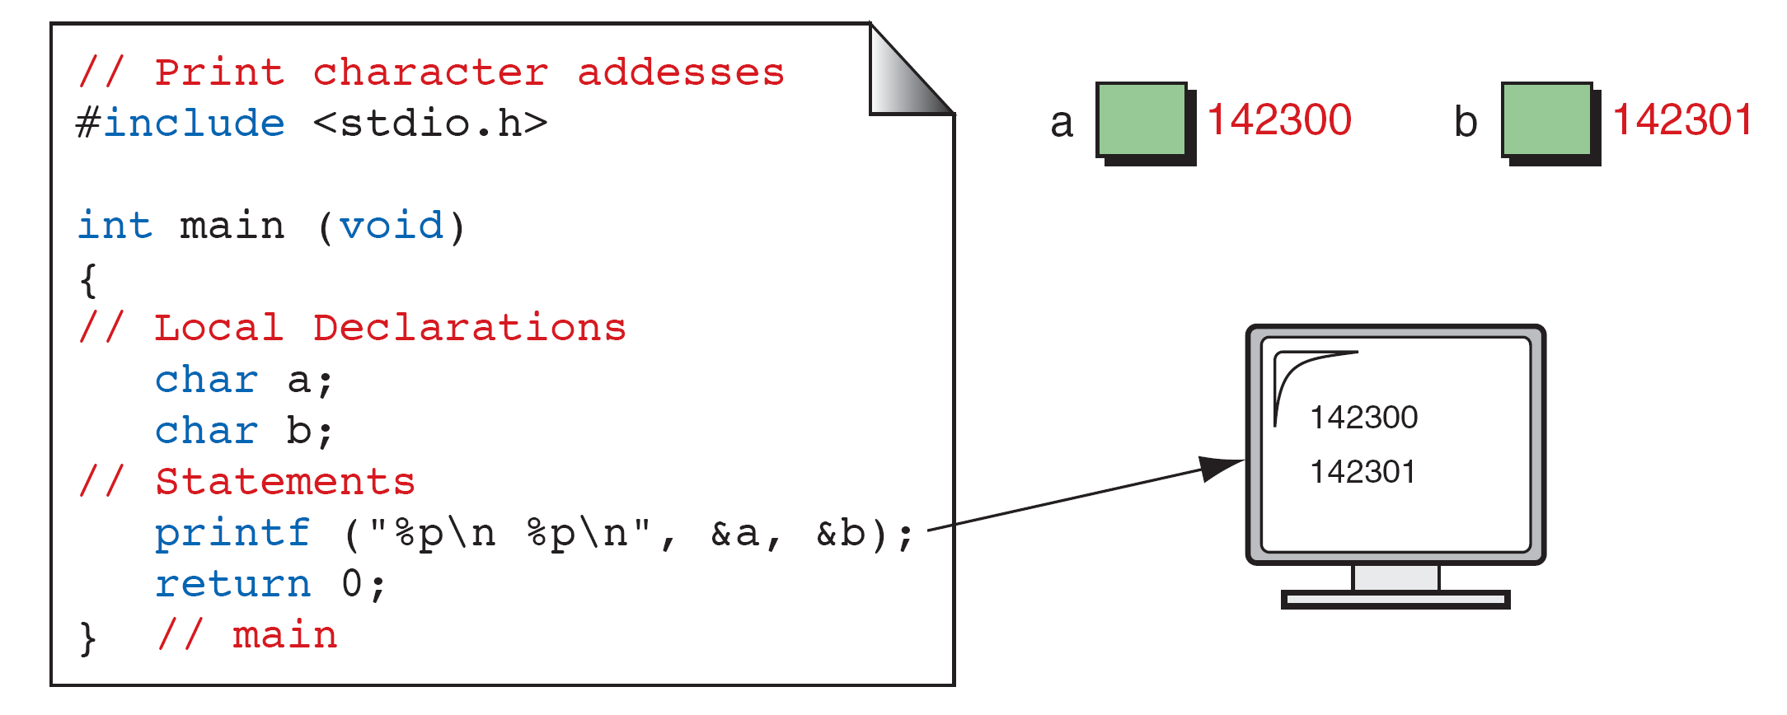
An address expression(unary expression) consists of an
ampersand (&) and a variable name.
The address operator (&) extracts the address for a variable.
The address operator format is: &variable_name
Print Character Addresses

Slide 8
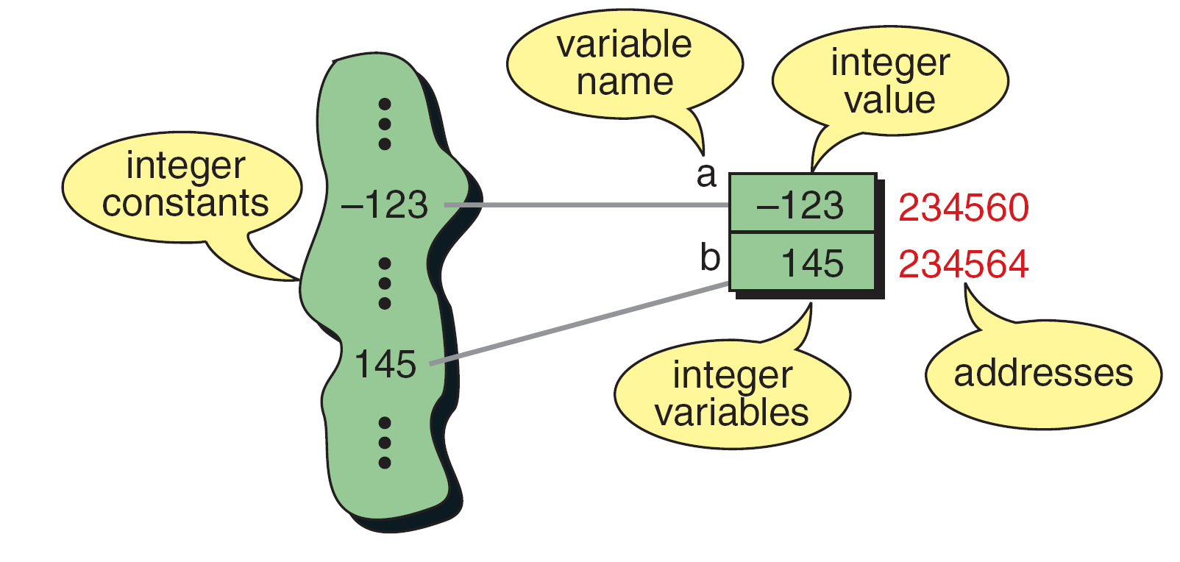
A variable’s address is the first byte occupied
by the variable.
Integer Constants and Variables

Slide 9
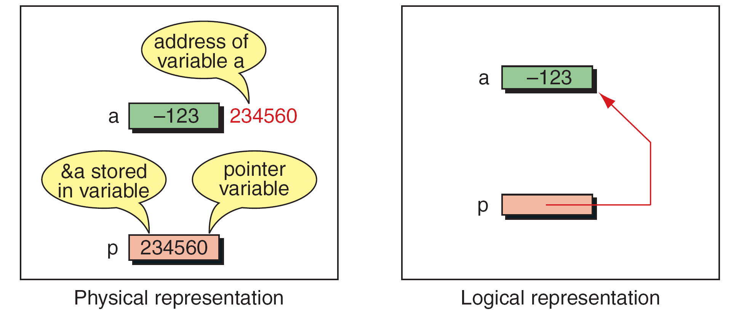
Pointer variable can store the address of a variable into another variable.
Pointer Variable

Slide 10
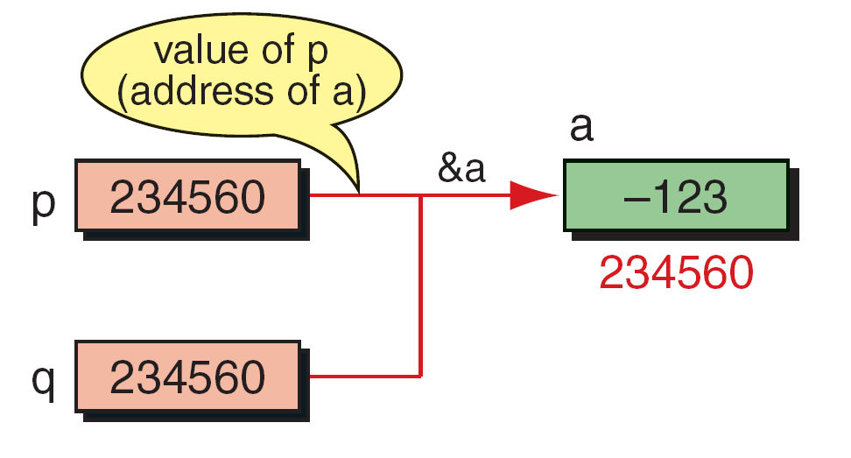
Multiple Pointers to a Variable

Slide 11
Note
A pointer that points to no variable contains the
special null-pointer constant, NULL.

Slide 12
Accessing Variables Through Pointers
An indirect expression, one of the expression types in the unary expression category, is coded with an asterisk (*) and an identifier.
The indirection operator is a unary operator whose operand must be a pointer value.
For example, to access the variable a through the pointer p, we simply code *p
The indirection operator is: *p

Slide 13
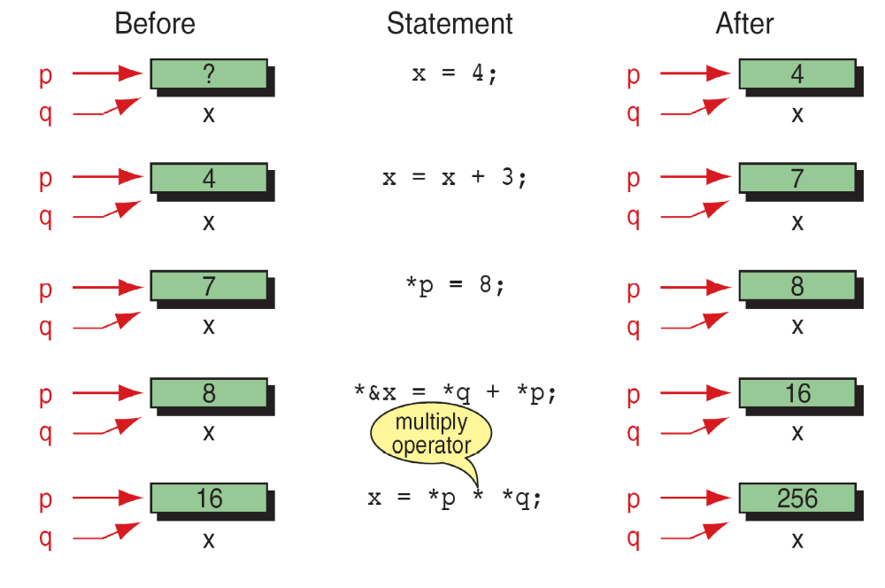
Accessing Variables Through Pointers

Slide 14

The Indirection and Address Operators are the inverse of each other.
Address and Indirection Operators

Slide 15
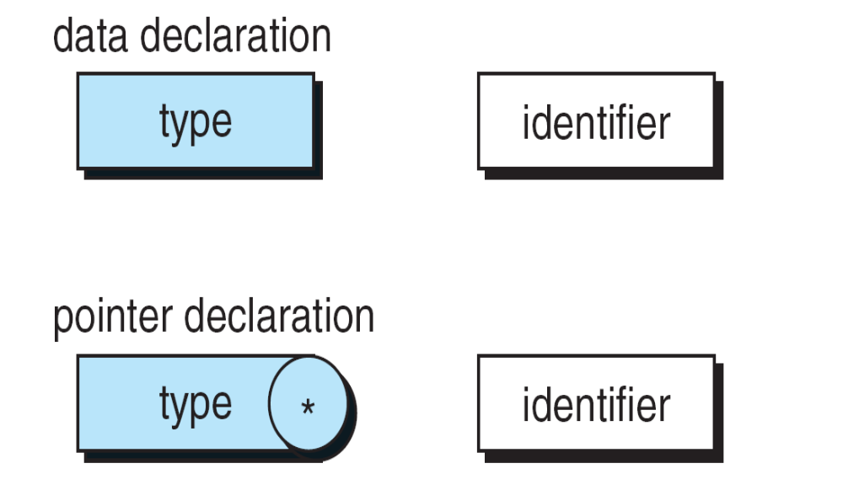
Pointer Variable Declaration

Slide 16
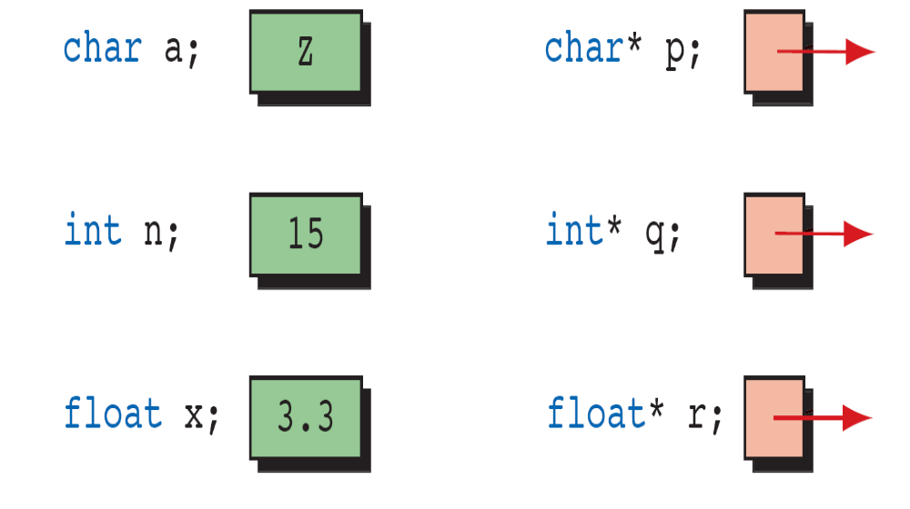
Declaring Pointer Variables

Slide 17
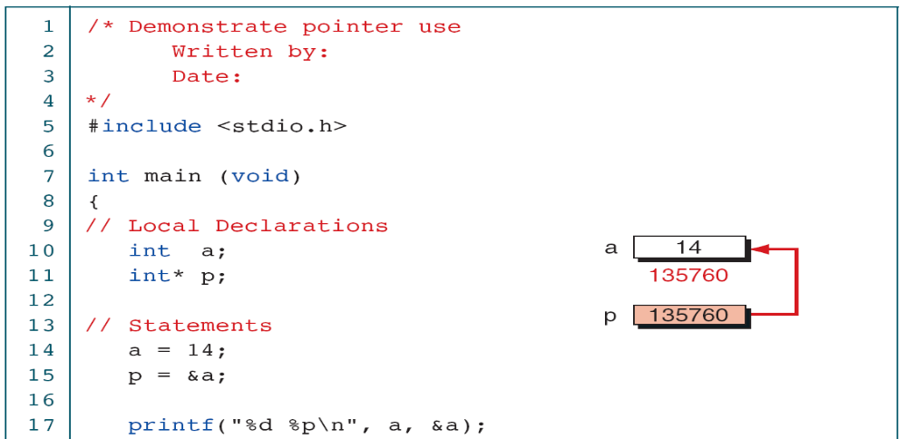
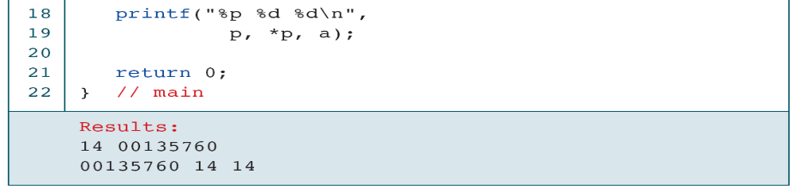
Demonstrate Use of Pointers

Slide 18
Declaration versus Redirection
An asterisk operator can be used in two different contexts:
For declaration and for redirection.
Declaration: When an asterisk is used for declaration,
it is associated with a type.
For example, we define a pointer to an integer as
int *pa;
int *pb;
Redirection: When used for redirection, the asterisk is an operator
that redirects the operation from the pointer variable to a
data variable.
For example, given two pointers to integers, pa and pb, sum is
computed as int sum = *pa + *pb;

Slide 19
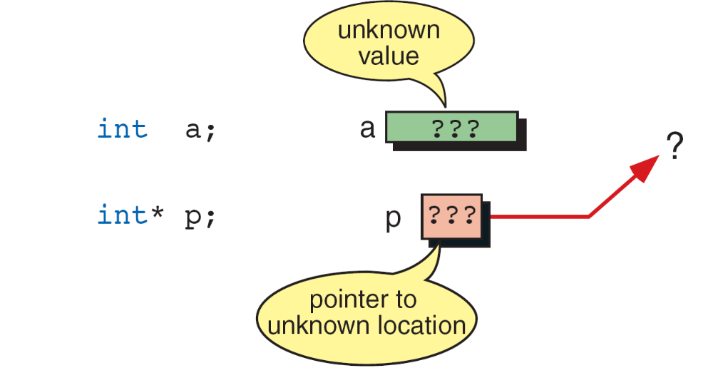
Uninitialized Pointers

Slide 20
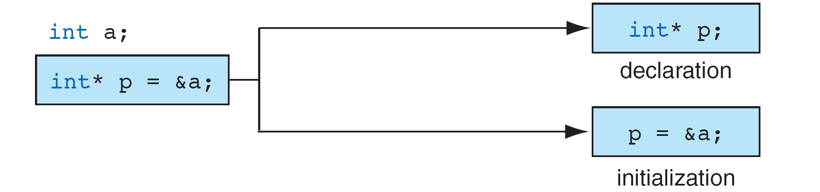
Example:
int a; //variable-value unknown
int *p = &a; //p has valid address
*p = 98; //a assigned value 98
Initializing Pointer Variables

Slide 21
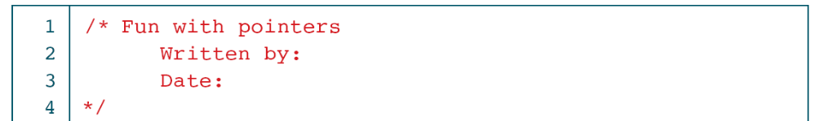
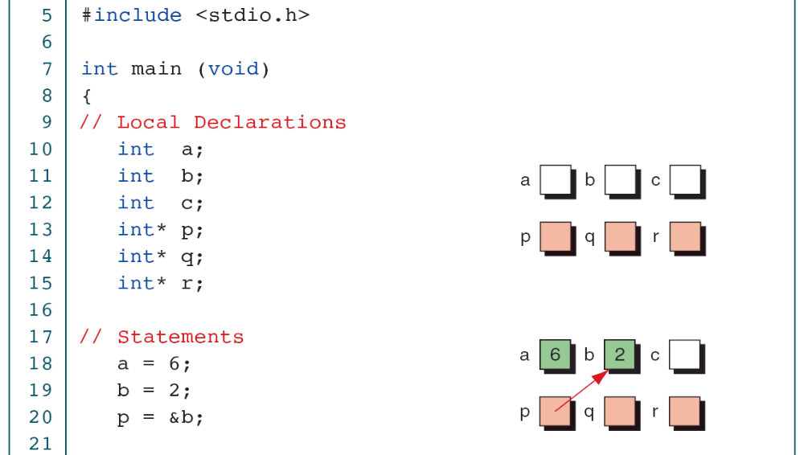

Slide 22
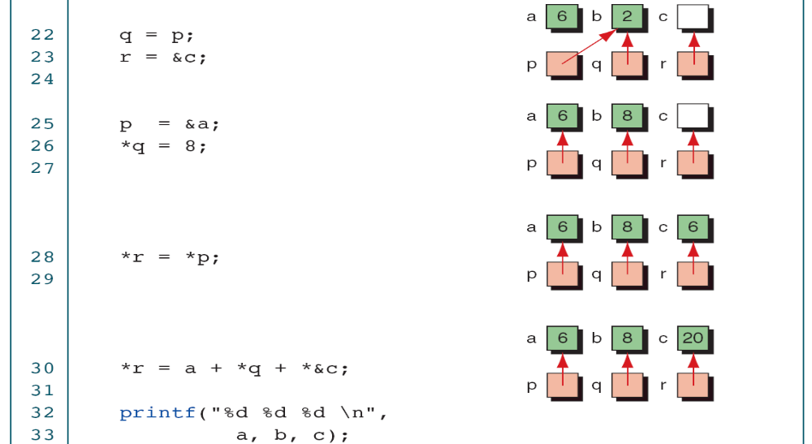
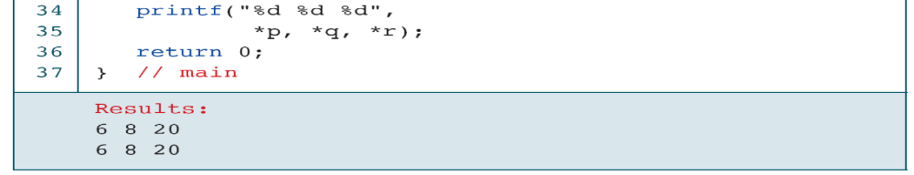

Slide 23
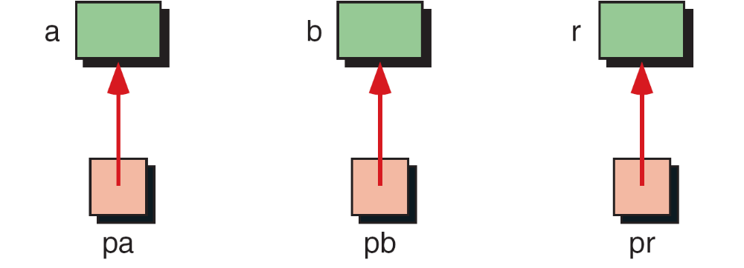
Add Two Numbers Using Pointers

Slide 24
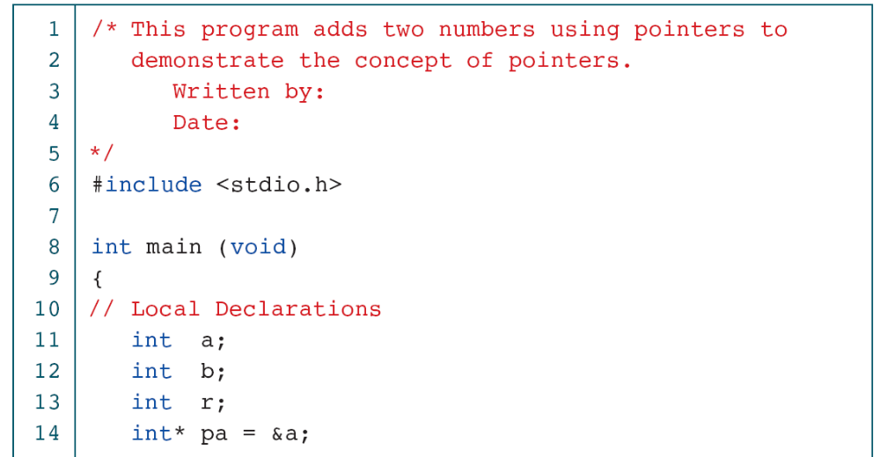
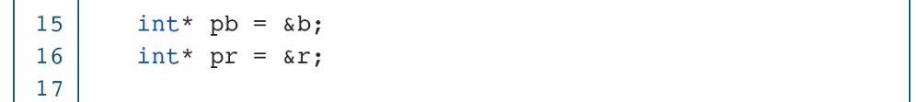
Add Two Numbers Using Pointers

Slide 25
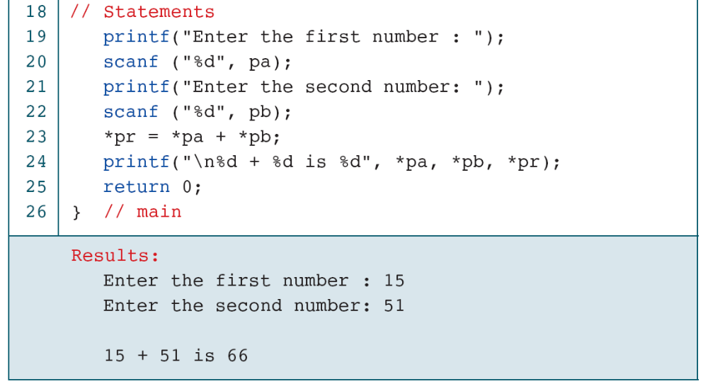
Add Two Numbers Using Pointers

Slide 26
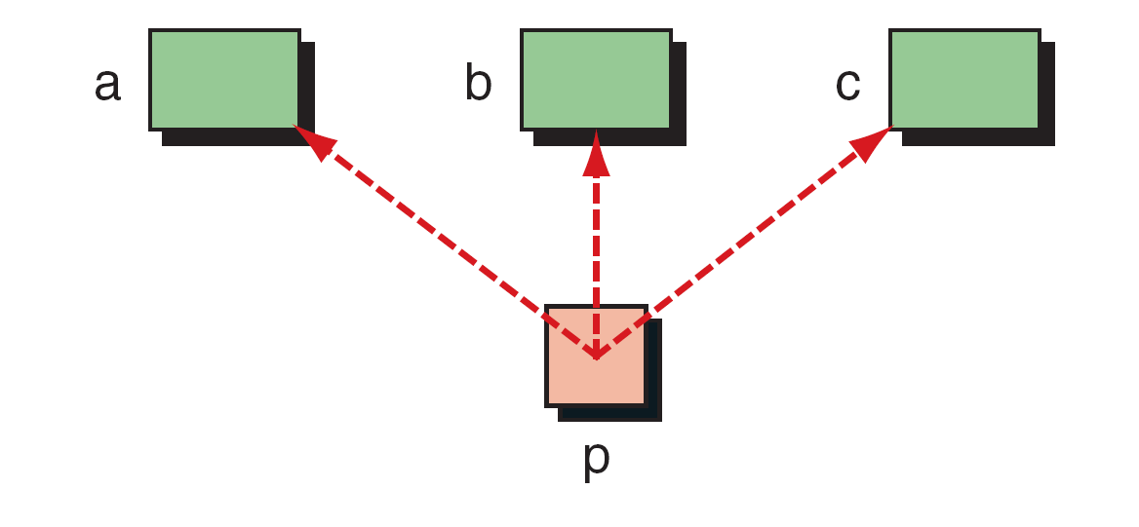
Demonstrate Pointer Flexibility

Slide 27
Using One Pointer for Many Variables

Slide 28
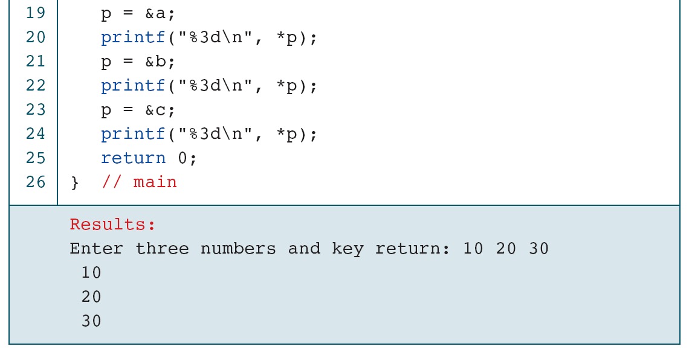
Using One Pointer for Many Variables

Slide 29
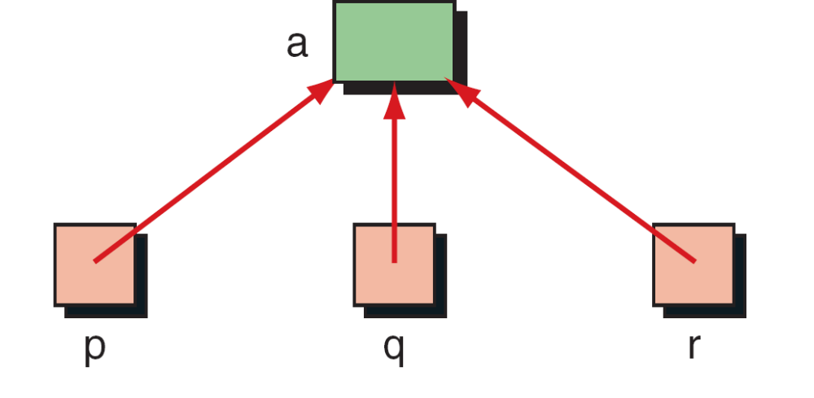
One Variable with Many Pointers

Slide 30
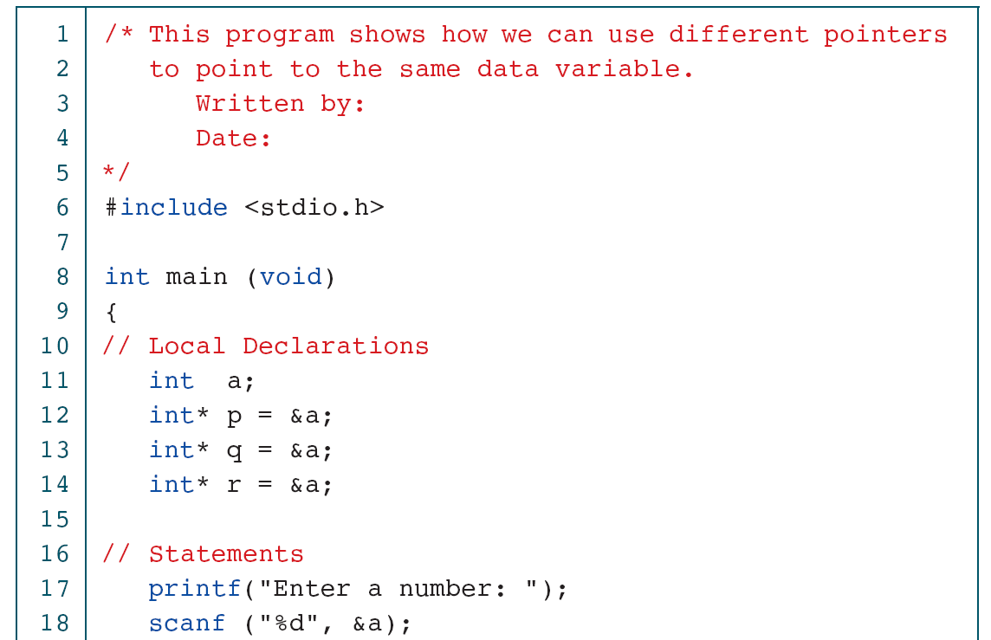
Using A Variable with Many Pointers

Slide 31
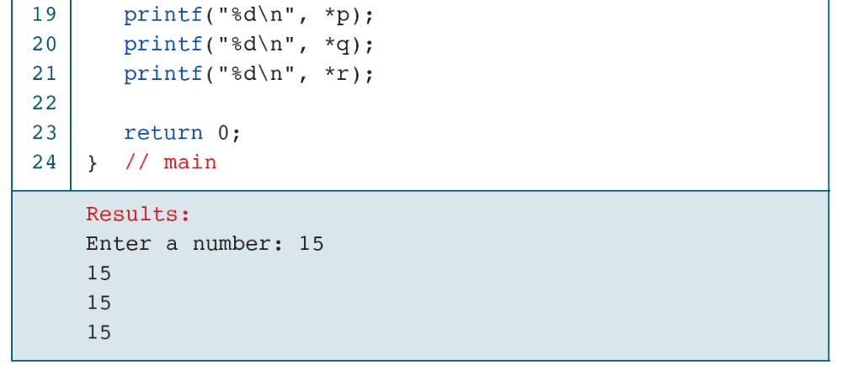
Using A Variable with Many Pointers

